Slide 1
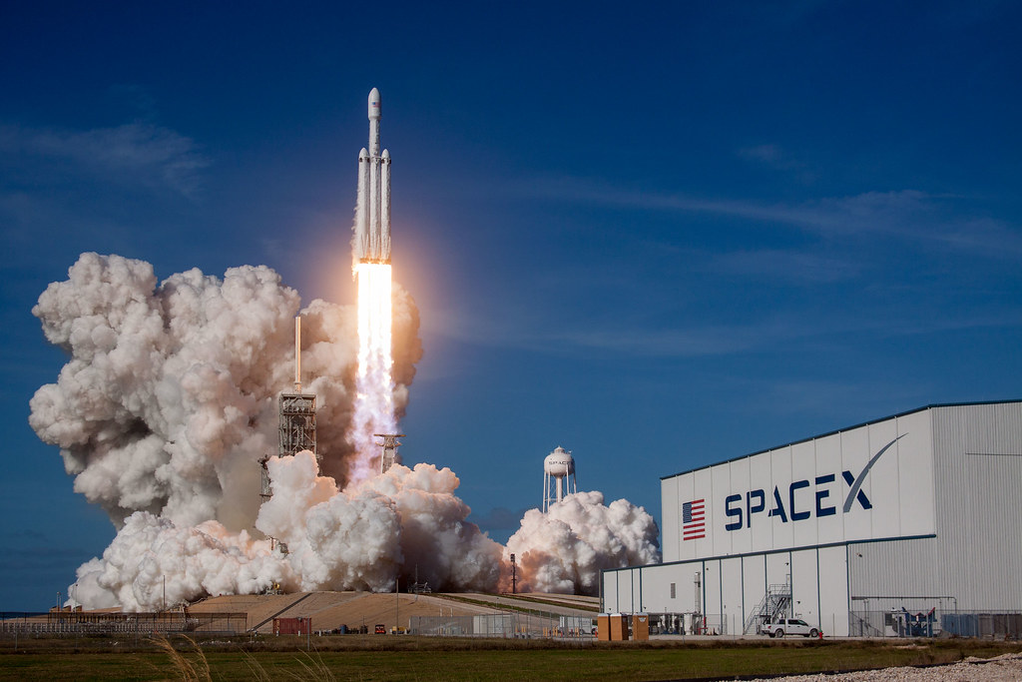
Title: SpaceX Data Analysis
Presenter Name: Gauri Tomar
Course: Applied Data Science Capstone by IBM
Platform: Coursera
Date: 5 April 2026
Github URL: https://github.com/Gauribuild/IBM-Applied-Data-Science-Capstone

Slide 2
OUTLINE:
Executive Summary
Introduction
Methodology
Results
Conclusions
Appendix

Slide 3
EXECUTIVE SUMMARY
Data Collection of SpaceX using APIs and Web Scraping
Data Wrangling
Summary of Methodologies
Exploratory Data Analysis using SQL & results with screenshots.
Exploratory Data Analysis with Data Visualization & results with screenshots
Generation of interactive map with Folium & results with screenshots.
Building a dashboard with Plotly Dash & results with screenshots.
Predictive Analysis & results with screenshots.
Results

Slide 4
INTRODUCTION
About the project:
SpaceX advertises rocket launches at a significantly lower cost compared to other providers, largely due to their ability to reuse the first stage of the rocket. The aim of this capstone project is to predict whether the Falcon 9 first stage will land successfully or not, which will help us in determining the cost of SpaceX rocket launches. The competitor companies can also use the findings to bid against SpaceX for a rocket launch.
Questions to be answered:
What factors influence the successful landing of the Falcon 9 first stage?
How can we accurately predict the landing outcome using machine learning models?
Which machine learning model performs best in predicting the landing success?

Slide 5

METHODOLOGY

Slide 6
DATA COLLECTION & WRANGLING METHODOLOGY
1- DATA COLLECTION:
Data collection was done using SpaceX API and Web Scraping. The records obtained from these two methods were later combined to form a cohesive dataset of relevant data and was turned into a csv file.
Data Collection using SpaceX API:
Collected date with help of API requests from SpeceX REST API.
Decoding the response content using json() and turning it into a dataframe using json_normalize().
Created dataframe and filtered the dataframe it includes Falcon 9 launches only.
The columns which were obtained by using SpaceX REST API – FlightNumber, Date, BoosterVersion, PayloadMass, Orbit, LaunchSite, Outcome, Flights, GridFins, Reused, Legs, LandingPad, Block, ReusedCount, Serial, Longitude, Latitude.
Data Collection Using Web Scraping:
Requesting Falcon 9 launch data from Wikipedia.
Creating a BeautifulSoup object from the HTML response and collecting the data by parsing HTML tables.
The columns obtained after web scraping – Flight No., Launch site, Payload, PayloadMass, Orbit, Customer, Launch outcome, Version Booster, Booster landing, Date, Time.
Github URL: https://github.com/Gauribuild/IBM-Applied-Data-Science-Capstone/blob/main/jupyter-labs-spacex-data-collection-api%20(1).ipynb

Slide 7
2- DATA WRANGLING:
Data wrangling involves cleaning, transforming, and organizing raw data into a structured format suitable for analysis.
The data collected with API and web scraping was integrated using data wrangling.
Identified data inconsistencies and filled/removed missing values in the dataset.
Ensured the column names and data formats across datasets is consistent.
Converted data types into appropriate formats and standardized the text.
Checked for duplicate records and removed them.
Verified the accuracy and consistency of data entries.
Selected relevant features for analysis and selected relevant features for analysis.
Github URL: https://github.com/Gauribuild/IBM-Applied-Data-Science-Capstone/blob/main/jupyter-labs-webscraping.ipynb
Github URL: https://github.com/Gauribuild/IBM-Applied-Data-Science-Capstone/blob/main/labs-jupyter-spacex-Data%20wrangling.ipynb

Slide 8
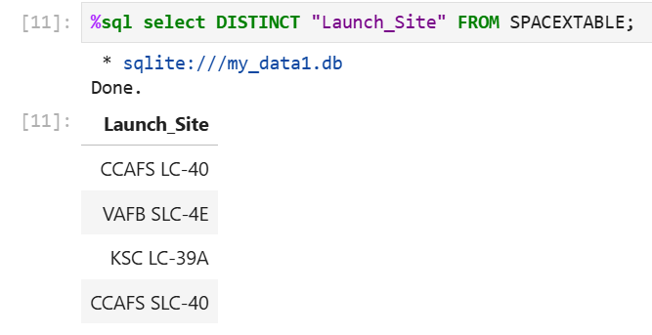
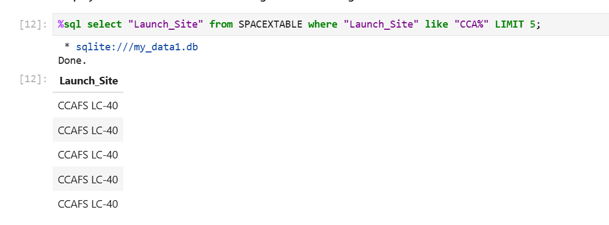
EDA WITH SQL
Calculated total number of launches.
Counted successful and failed launches.
Calculated success rates by launch site and rocket type.
Nested queries to calculate derived metrics (e.g., average payload mass per launch site).
Subqueries used to perform detailed analysis within larger datasets.
Filtered data to focus on specific launch outcomes.
Applied conditions to extract launches based on criteria like launch date or rocket configuration.
INSIGHTS FROM EDA WITH SQL:
Displayed the names of all distinct launch sites
Launch Site Names Begin with 'CCA'

Slide 9
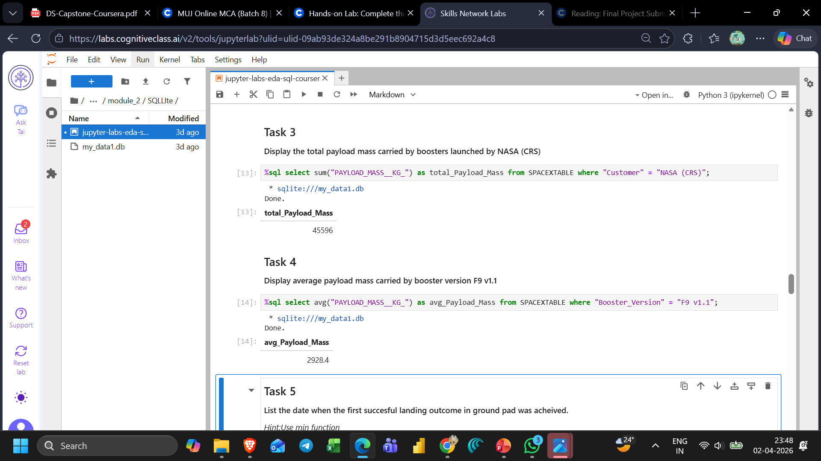
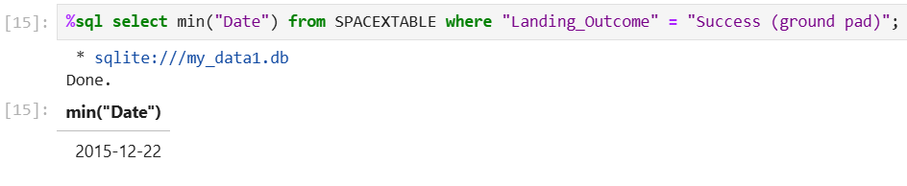
Total Payload Mass
Average Payload Mass by F9 v1.1
First Successful Ground Landing Date

Slide 10
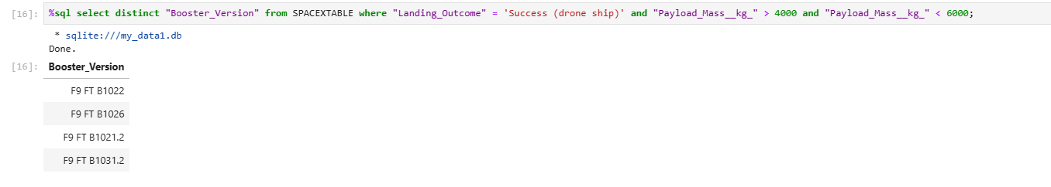
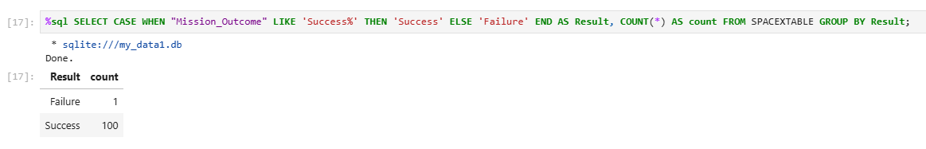
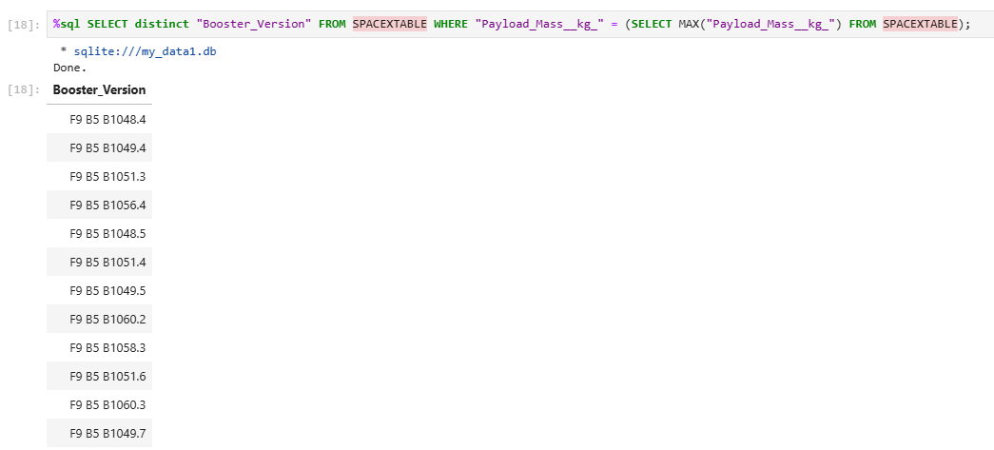
Successful Drone Ship Landing with Payload between 4000 and 6000
Total Number of Successful and Failure Mission Outcomes
Boosters Carried Maximum Payload

Slide 11
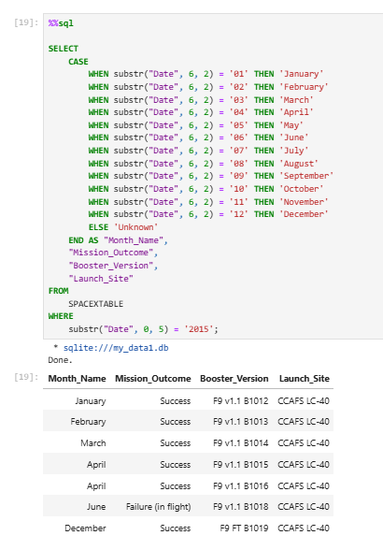
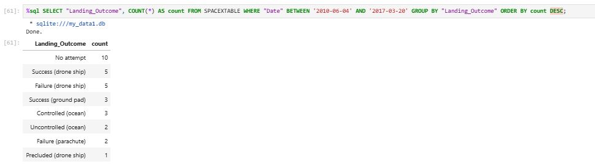

2015 Launch Records
Rank Landing Outcomes Between 2010-06-04 and 2017-03-20
Github URL: https://github.com/Gauribuild/IBM-Applied-Data-Science-Capstone/blob/main/jupyter-labs-eda-sql-coursera_sqllite.ipynb

Slide 12
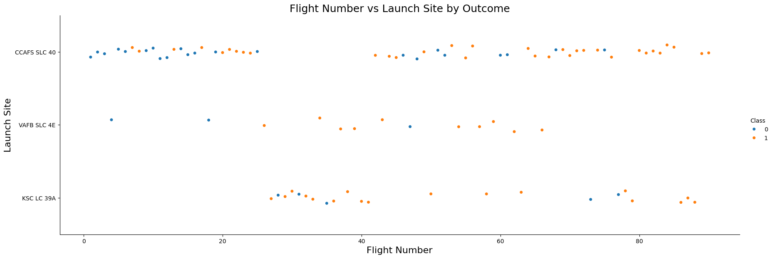
EDA WITH DATA VISUALIZATION:
.Plotted bar graph to compare categorical variables such as launch outcomes (success/failure) across different categories like launch sites or rocket types.
Plotted line graph to track trends over time, such as the success rate of Falcon 9 launches across different years.
Plotted scatter plots to explore relationships between two numerical variables (payload mass vs. launch success).
INSIGHTS FROM EDA WITH DATA VISUALIZATION:
Flight Number vs Launch Site
The CCAFS SLC 40 launch site has about a half of all launches.
VAFB SLC 4E and KSC LC 39A have higher success rates.
With every new launch, the rate of success increases.

Slide 13
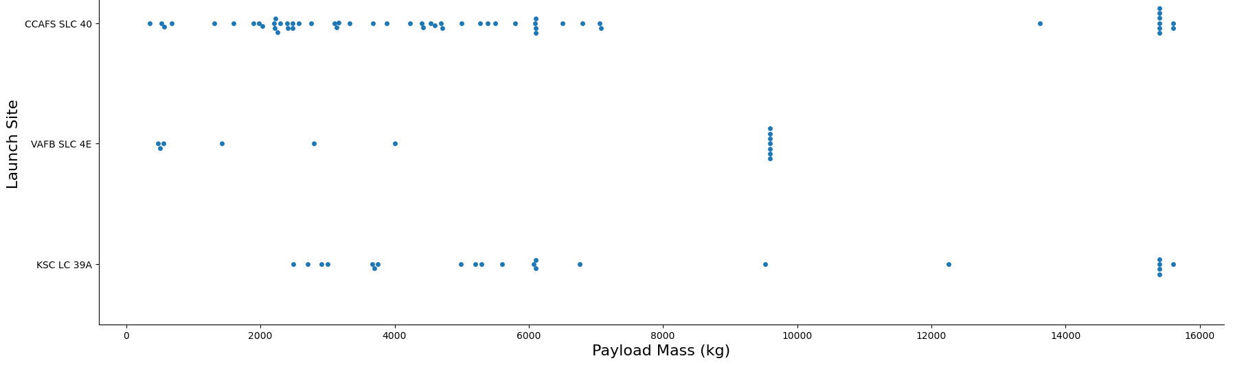
Payload vs. Launch Site
For every launch site the higher the payload mass, the higher the success rate.
Most of the launches with payload mass over 7000 kg were successful.
KSC LC 39A has a 100% success rate for payload mass under 5500 kg too.

Slide 14
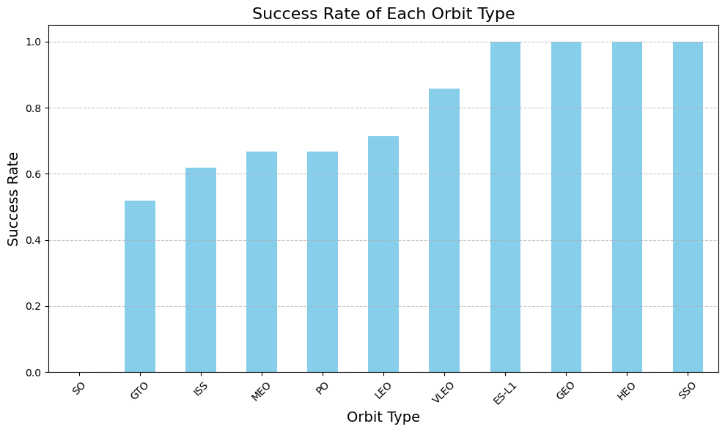
Success Rate vs. Orbit Type
Orbits with 100% success rate: ES-L1, GEO, HEO, SSO
Orbits with 0% success rate: SO
Orbits with success rate between 50% and 85%: GTO, ISS, LEO, MEO, PO

Slide 15
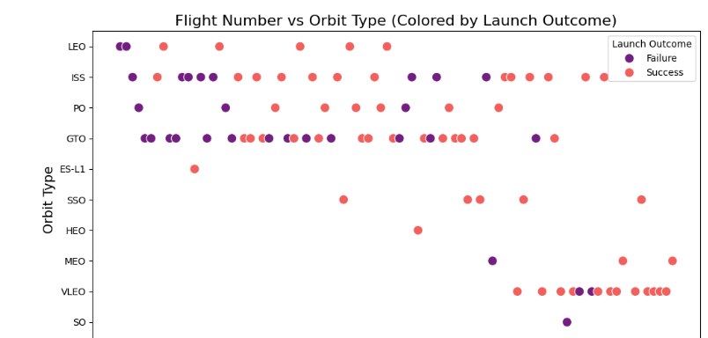
Flight Number vs. Orbit Type
Success rate of Falcon 9 launches increases with higher flight numbers
Early missions to GTO and ISS orbits showed mixed outcomes
Recent missions to these orbits have significantly higher success rates.

Slide 16
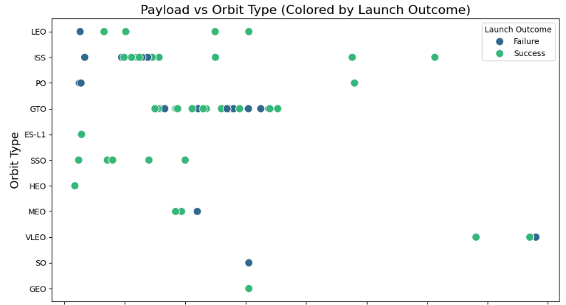
Payload vs. Orbit Type
Successful landings are more frequent across most orbit types
Higher success observed for payloads below 6000 kg
Payloads above 10,000 kg show mixed outcomes
Heavier payloads are associated with increased mission difficulty

Slide 17
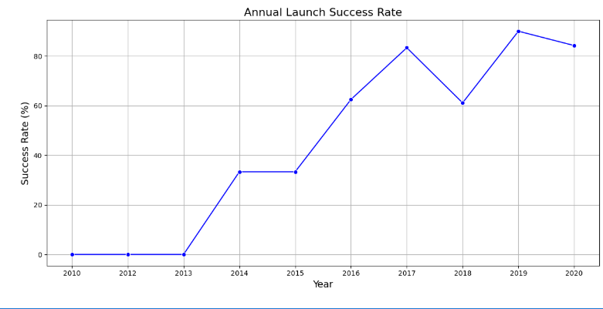
Launch Success Yearly Trend
Launch success rate improved significantly after 2013
Success rate reached over 80% by 2020
A temporary decline observed in 2018
Overall trend shows increasing reliability of Falcon 9 launches
Github URL: https://github.com/Gauribuild/IBM-Applied-Data-Science-Capstone/blob/main/jupyter-labs-eda-dataviz.ipynb

Slide 18
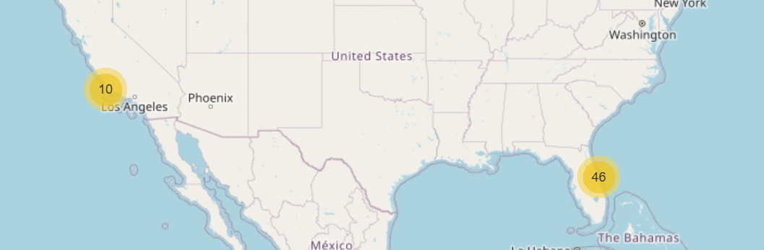
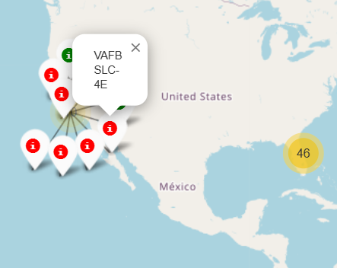
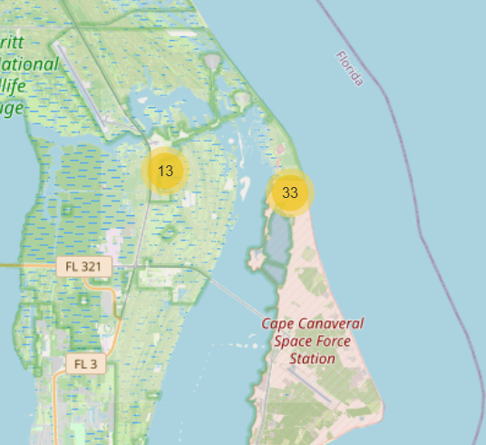
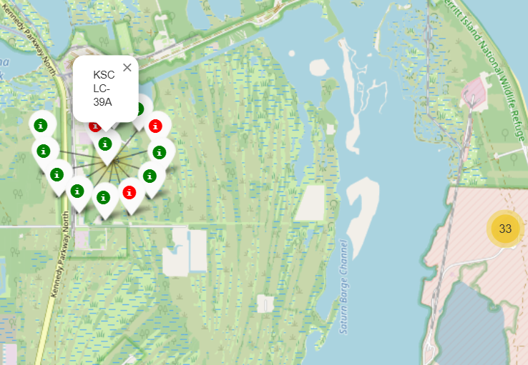
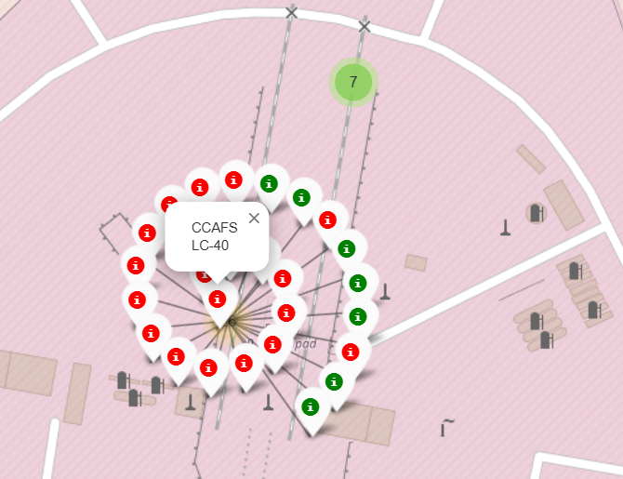
BUILD AN INTERACTIVE MAP WITH FOLIUM
Placed markers to indicate launch sites on the map.
Each marker represents a specific geographical location where SpaceX launches have occurred.
Added circles around launch sites to visually represent proximity zones.
Drew lines to connect launch sites with their proximities or other relevant locations.
INSIGHTS FROM FOLIUM MAPS:
all launch sites on a map
All launch sites are in close proximity to the coast.
All launch sites are not in close proximity to the Equator.
The risk of debris dropping near people is low.
The Cape Canaveral sites (CCAFS LC-40 and CCAFS SLC-40) and Kennedy Space Center (KSC LC-39A) are near the coast in Florida.
Vandenberg Air Force Base (VAFB SLC-4E) is also near the coast in California.

Slide 19
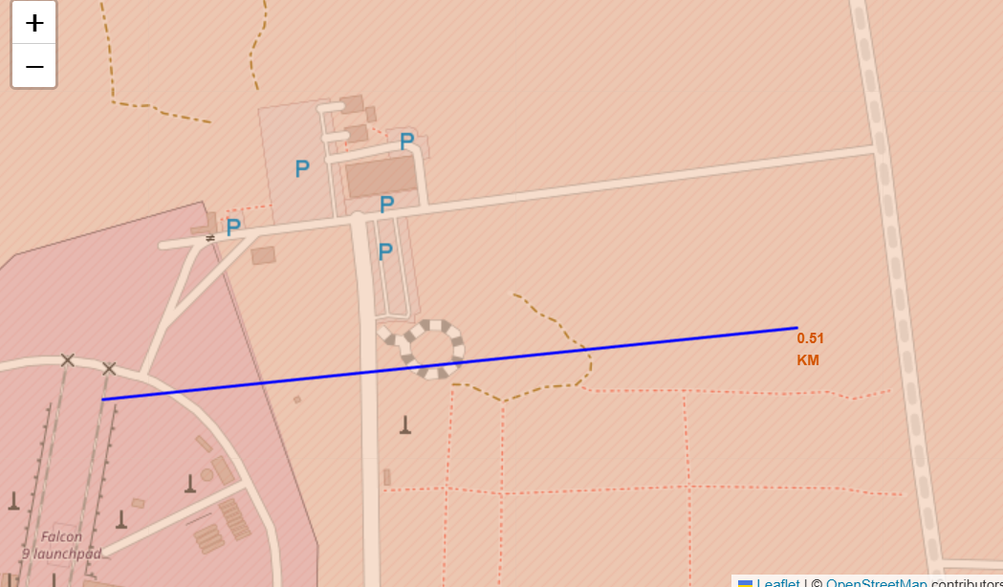
Mark the success/failed launches for each site on the map
Calculate the distances between a launch site to its proximities
Out of 26 launch sites for CCAFS LC-40, there are 19 red markers and 7 green markers.
The red markers might represent unsuccessful launches, while the green markers indicate successful ones.
The calculated distance between the CCAFS SLC-40 launch site and the closest coastline is approximately 0.51 kilometers, as indicated by the marker.
The added PolyLine clearly shows the straight-line distance, highlighting the proximity of the launch site to the coast.
This close-proximity to the coastline is typical for launch sites to facilitate over-water flight paths and safe recovery operations, ensuring minimal risk to populated areas
Github URL: https://github.com/Gauribuild/IBM-Applied-Data-Science-Capstone/blob/main/lab_jupyter_launch_site_location%20(1).ipynb

Slide 20
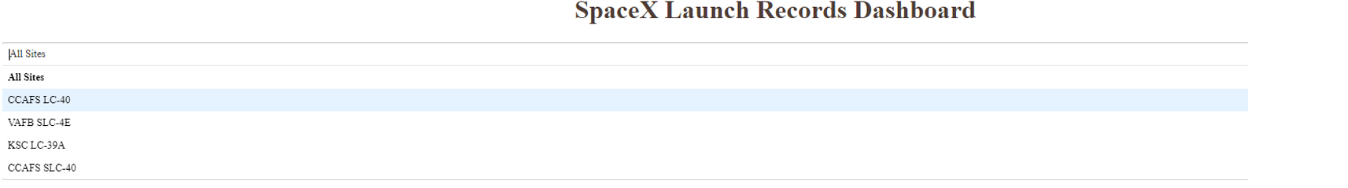
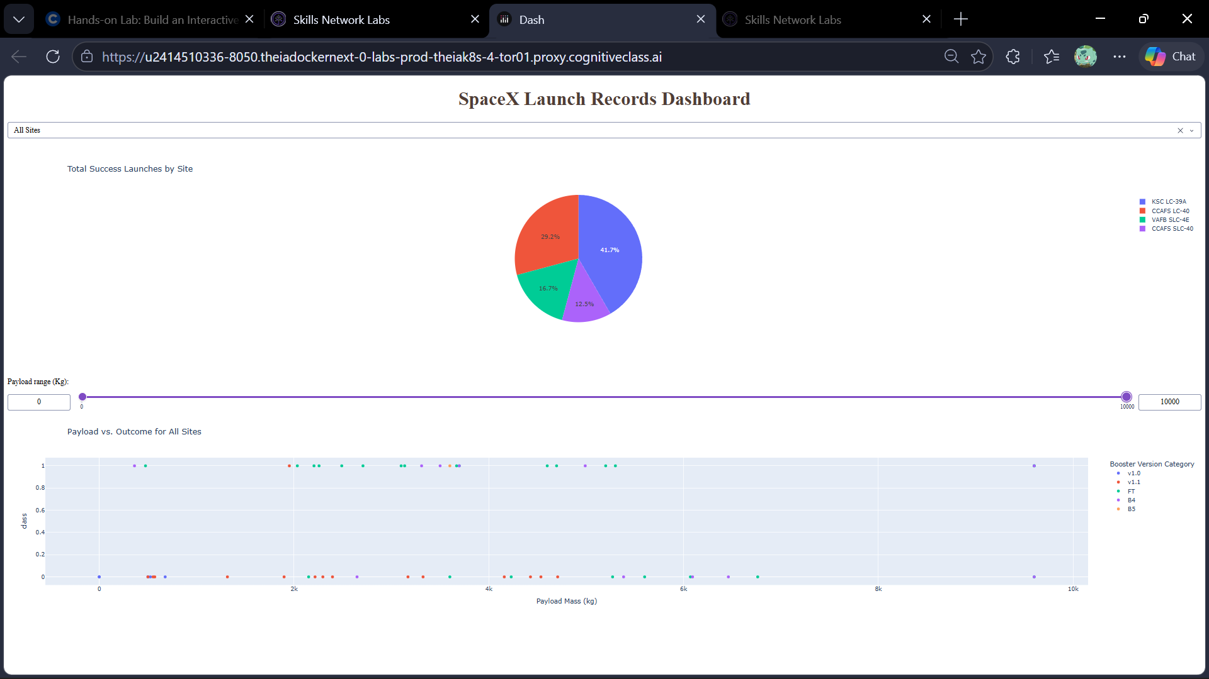
BUILD A DASHBOARD WITH PLOTLY DASH
Added success Pie Chart to display the distribution of successful and failed launches which helps visualize the overall success rate and performance trends.
Added Launch Site Dropdown which enables users to select specific launch sites for analysis and, facilitates filtering and focused exploration based on geographical locations.
Added Success-Payload Scatter Plot that shows the relationship between payload mass and launch success which allows users to explore how payload mass influences mission outcomes.
INSIGHTS FROM SPACEX LAUNCH DASHBOARD:
Launch Site Dropdown showing all the names of launch sites.
CCAFS LC-40: 29.2%
VAFB SLC-4E: 16.7%
CCAFS SLC-40: 12.5%
KSC LC-39A: 41.7%
The KSC LC-39A launch site has the highest number of successful launches, making up 41.7% of the total successes. This indicates that KSC LC-39A is a highly reliable site for SpaceX launches.

Slide 21
CCAFS LC-40 has the highest success rate with 43.7% of successful launches.
This suggests that CCAFS LC-40 is the most reliable launch site among the ones analyzed.
Other sites like KSC LC-39A, VAFB SLC 4E, and CCAFS SLC-40 have lower success rates, indicating variability in launch success across different sites.
Booster version “FT” appears to be the most frequently used and has a high success rate across various payload masses.
Booster version “v1.0” has fewer launches and may require further analysis to understand its performance.
Overall, booster versions do not show a clear trend that higher payload masses correlate with lower success rates.
Github URL: https://github.com/Gauribuild/IBM-Applied-Data-Science-Capstone/blob/main/spacex-dash-app.py

Slide 22
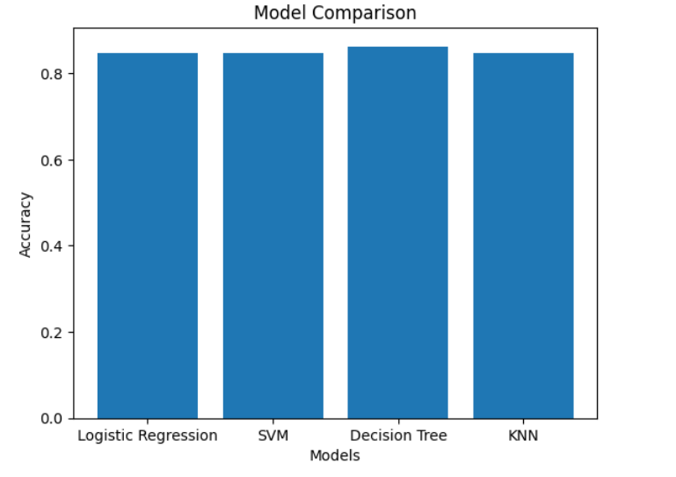
PREDICTIVE ANALYSIS (CLASSIFICATION)
Created a NumPy array from the column "Class" in data.
Standardized the data with StandardScaler, then fitted and transformed it.
Split data into training and test sets for model validation.
Used GridSearchCV to systematically search for optimal hyperparameters.
Tuned parameters such as C (SVM), max_depth (Decision Trees), and n_neighbors (KNN).
Calculating the accuracy on the test data using the method.score() for all models.
Identified the model with the highest accuracy on the test set as the best performer.
INSIGHTS FROM PREDICTIVE ANALYSIS:
Based on the results, the Decision Tree model has the highest classification accuracy on the test data, achieving an accuracy of 0.9444.
This suggests that the Decision Tree model is better suited for this dataset compared to Logistic Regression, Support Vector Machine, and K Nearest Neighbors, all of which achieved an accuracy of 0.8333.

Slide 23
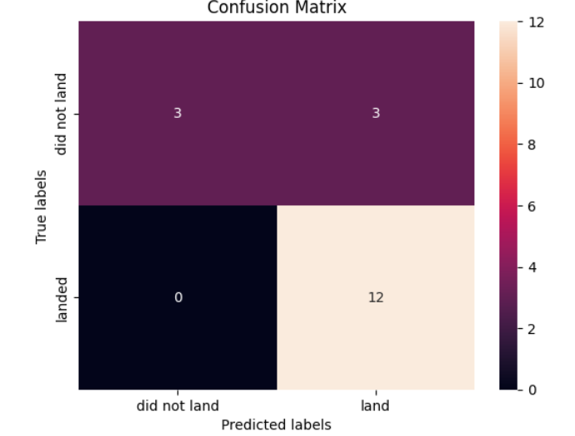
The model predicted 12 successful landing showing reliability.
It also correctly identified 3 failed landings
There are 0 False Negatives, meaning the model never missed an actual successful landing.
Github URL: https://github.com/Gauribuild/IBM-Applied-Data-Science-Capstone/blob/main/SpaceX_Machine%20Learning%20Prediction_Part_5%20(3).ipynb

Slide 24
RESULTS
Our analysis revealed that the "KSC LC-39A " launch site has the highest success rate among all sites, accounting for 41.7% of successful launches. This indicates that this site might have optimal conditions or processes that contribute to a higher success rate.
The scatter plot analysis showed that the "FT" booster version has a high success rate across various payload masses, demonstrating its reliability and robustness compared to other booster versions. This suggests that future missions might benefit from utilizing this booster version for improved success rates.
The success rate of launches increases over the years.
Orbits ES-L1, GEO, HEO and SSO have 100% success rate.
Launches with a low payload mass show better results than launches with a larger payload mass.
CONCLUSION:
Our predictive analysis and interactive visualizations have not only shed light on key factors influencing SpaceX's launch success but also provided a robust framework for future assessments and decision-making in the aerospace industry. The insights gathered can help improve launch strategies and contribute to the ongoing success of reusable rocket technology

Slide 25
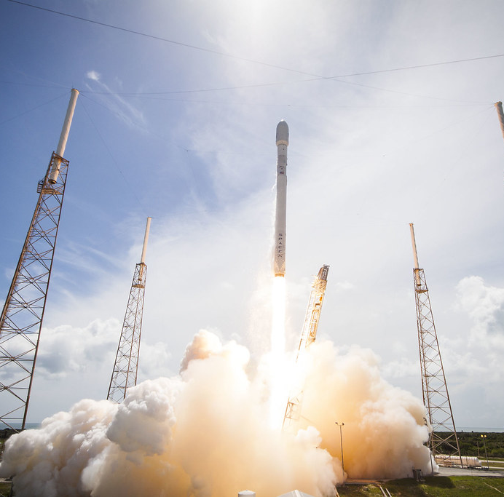
THANK YOU

